Slide 1

Time Series forecasting- Auto Regressive Models
Dr. Jia Uddin
Technology Studies
Endicott College, Woosong University
Daejeon, South Korea
Email: jia.Uddin@wsu.ac.kr
Notes:
https://online.stat.psu.edu/stat501/lesson/14/14.1

Slide 2
Linear Time series data
Time series data is a sequence of observations collected from a process with equally spaced periods of time
Example:
Daily data on sales
Daily customers
Monthly interest rates, costs
Monthly unemployment rates
Daily closing prices of stock, etc..

Slide 3
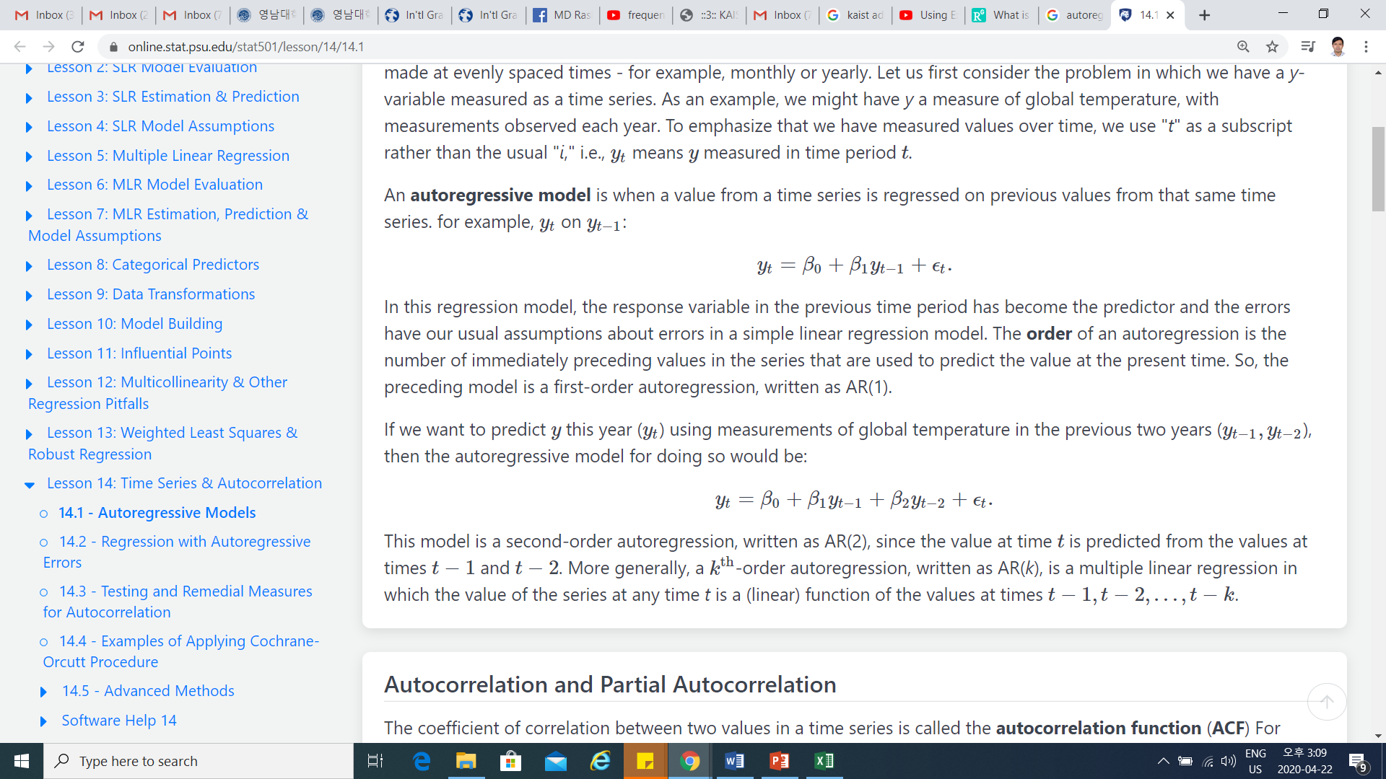
Autoregressive models
Notes:
https://www.mathsisfun.com/algebra/linear-equations.html

Slide 4
Autoregressive models
Notes:
https://www.mathsisfun.com/algebra/linear-equations.html

Slide 5
Autoregressive models
Notes:
https://www.mathsisfun.com/algebra/linear-equations.html

Slide 6
Autoregressive models
Typically, you use the coefficient p-values to determine which terms to keep in the regression model.
Notes:
https://www.mathsisfun.com/algebra/linear-equations.html

Slide 7
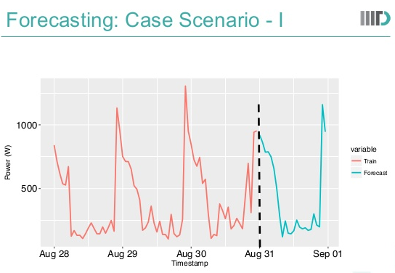
Forecasting
Time series forecasting: involve the prediction of future values of a variable based entirely on the past and present observation of that variable
Data collected at regular intervals of time
Example: Weather, electricity forecasting

Slide 8
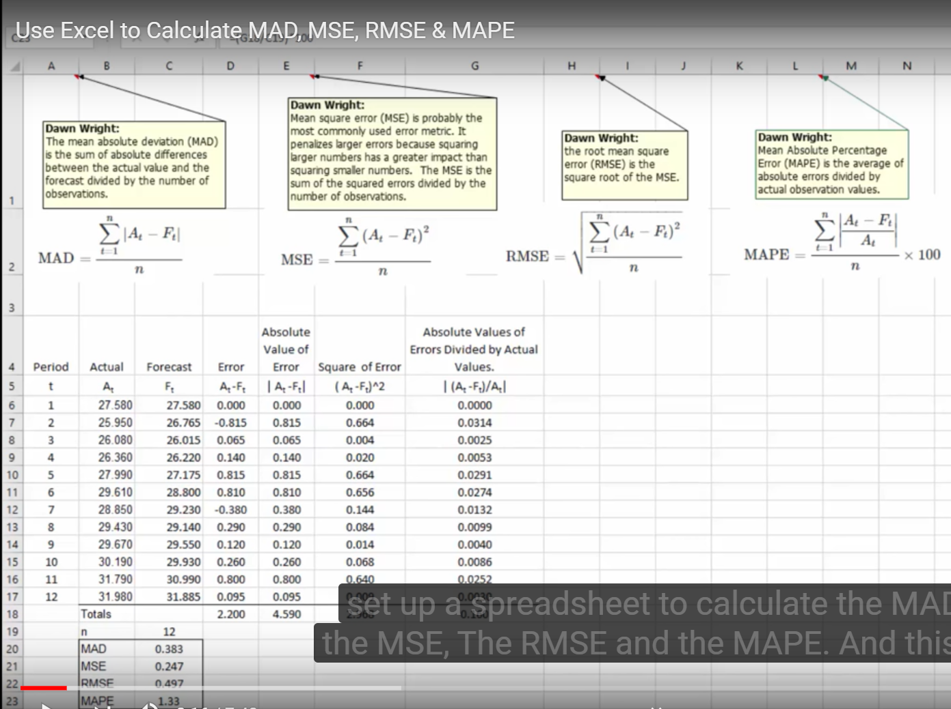
MAD, MSE, RMSE, MAPE
Mean Absolute Deviation (MAD) the Mean Square Error (MSE), The Root Mean Square Error (RMSE), and the Mean Absolute Percentage Error (MAPE)

Slide 9
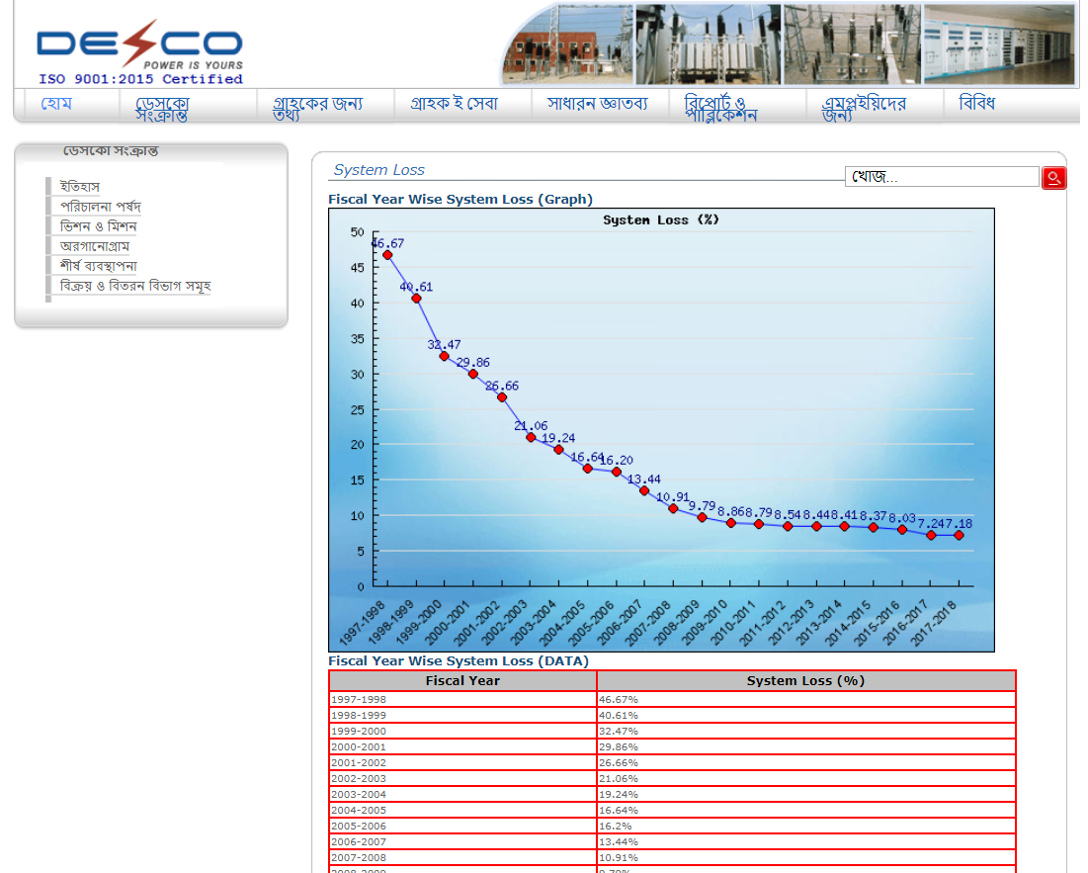
Data set
https://www.desco.org.bd/newsysadmin/sysloss_b.php
Notes:
https://www.desco.org.bd/newsysadmin/sysloss_b.php

Slide 10
Forecasting using auto regressive models
Mathematical equation of multiple linear regression:
For related lab activity please see the excel file uploaded in SMART LMS
https://www.youtube.com/watch?v=bkb2vEa5Ku4&t=64s
Notes:
https://www.monash.edu/business/marketing/marketing-dictionary/n/naive-forecasting

